Slide 1
CSE 321
Real -Time and Embedded Operating Systems

Slide 2

Documentation
In general, documentation is critical
Allows for proper design
Allows for efficient maintenance
This is a critical idea all around and it comes in many forms
Some cases will need all the types of documentation, some will not

Slide 3
Why do we care about this now?
Why not care?
Reality is collaborative...you are one step closer to those projects and jobs if you aren’t there already
Others will read, maintain, debug, and modify your code
Academic Integrity

Slide 4
What things can go in documentation?
Specifications
Features
Applications
Revision History
Quick Start
Conventions
Block Diagrams
Logic Description
Schematics
Timing Diagrams
Circuit Description
Behavior Table
Test Plan
Active Levels
Name Explanations
Reference Designations
Pin configurations and functions
Operating Properties
Glossary
Bill of Materials
ASM (Algorithm State Machine)
FSM (Finite State Machine)
Flow Chart

Slide 5
How do you know what to include?
It will be in the assignment instructions for each project
A template Table of Contents will be provided to guide you in building the content for your documentation

Slide 6
Some Key Documentation Elements

Slide 7
Specification
Often referred to as spec
Describes what the system should do
Inputs
Outputs
Functions
The what not the how in this part (you can have some with how in it)

Slide 8
Applications
The where and when for using this design

Slide 9

Revisions
Frequently things are “snowballed” … they are built on top of legacy materials
Not from scratch
Notes:
https://www.reddit.com/r/ProgrammerHumor/comments/gj7b82/building_on_top_of_legacy_code/

Slide 10
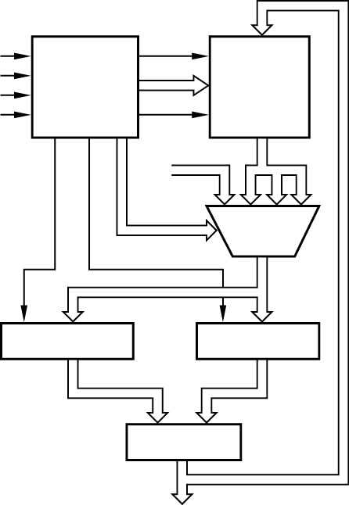
Block diagram
A high level graphical overview
Function modules
Basic interconnects
Notes:
Wakerly 5th Edition

Slide 11
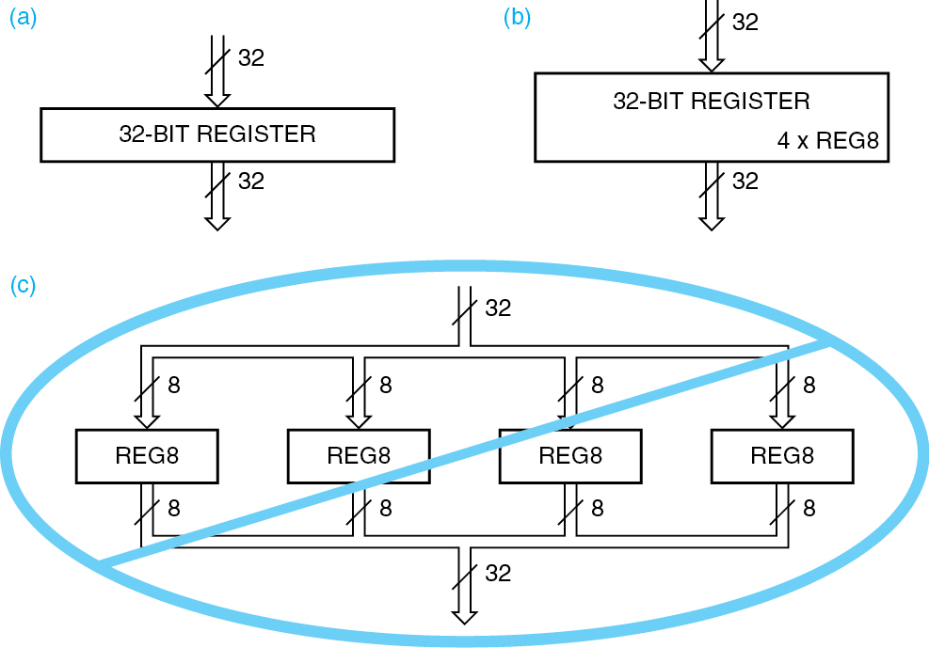
How much detail?
Notes:
Wakerly 5th Edition

Slide 12
Logic-device description
Functions that are custom
You see this with ASIC, FPGA, PLD, and CPLD type devices
ASIC- application specific integrated circuits
FPGA-field programmable gate array
PLD- programmable logic device
CPLD- complex programmable logic device
Mostly in English - but internal specifications need another approach to describe the behavior
Diagrams, equations and tables
HDL- Hardware descriptive language
Conventional languages (like C)

Slide 13
Logic Diagram vs Logic Schematic
Diagram: Basic
Schematic: More detailed, contains all the necessary stuff to actually build it, including electrical properties

Slide 14
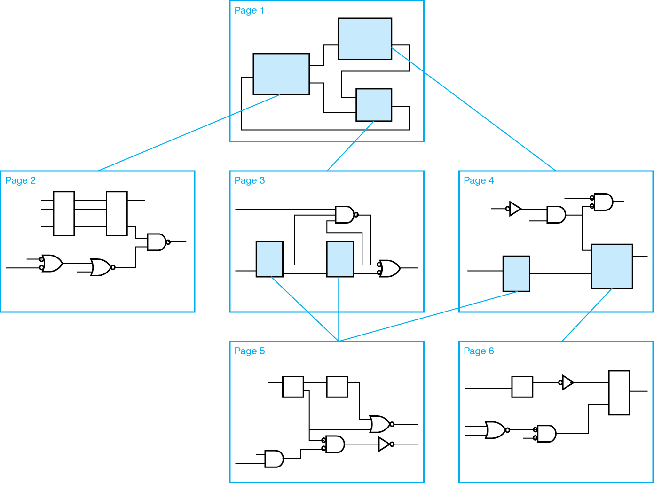
Not all schematics have the electrical detail, sometimes it is just more detail
Notes:
Wakerly 5th Edition

Slide 15
BOM - Bill of materials
You saw this on UB Learns
It typically won’t have links or as many options
It is the list of the components that are needed for implementation

Slide 16
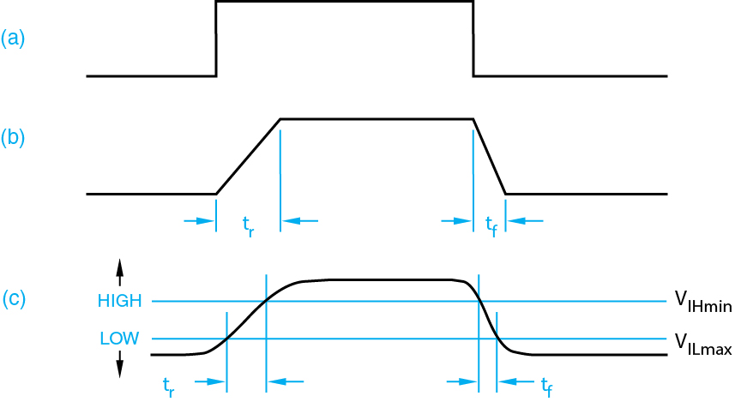
Timing Diagram
Time is real
Nothing is ideal
Nothing happens instantly
There are delays that can happen from the changes
This means everything is actually a signal
Notes:
Wakerly 5th Edition

Slide 17
Circuit Description
This gives more details to how the circuit works internally
There are a lot of operational considerations

Slide 18

Test Plan
Plans are good and important
What do good plans include?
Methods and resources to verify/test proper operation
This is for before, during, and after construction

Slide 19
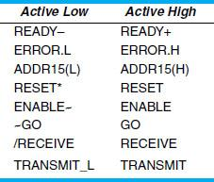
Names
Arbitrary, but good skills are important
What does a good name tell you?
What the purpose is for that signal or input
Active high or active low functionality
Be safe and define it still
Notes:
Wakerly 5th Edition

Slide 20
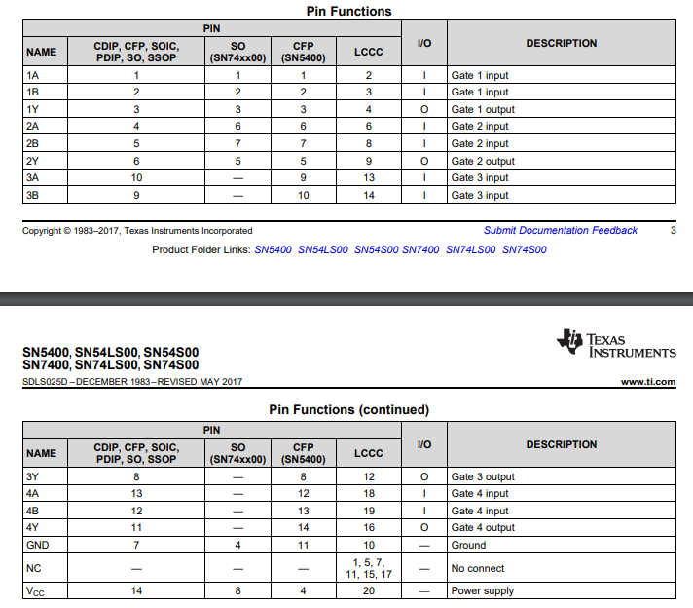
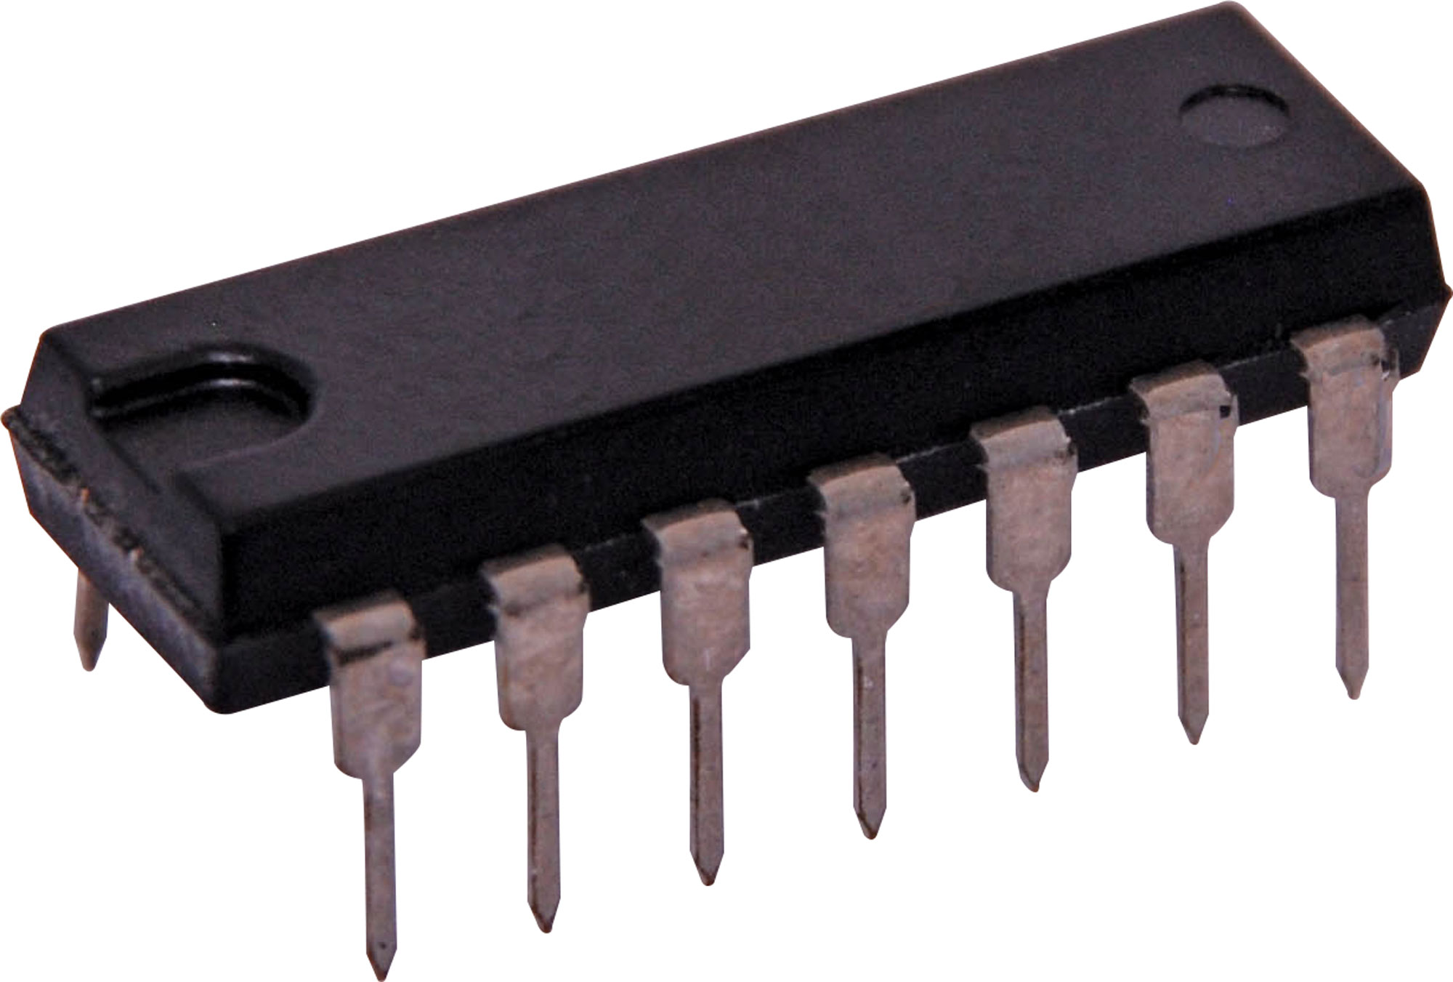
Reference Designation
Consider the notch or dot on your ICs from lab
Tells you orientation info
http://www.ti.com/lit/ds/sdls025d/sdls025d.pdf

Slide 21
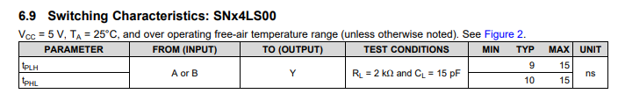
Time Properties
http://www.ti.com/lit/ds/sdls025d/sdls025d.pdf

Slide 22
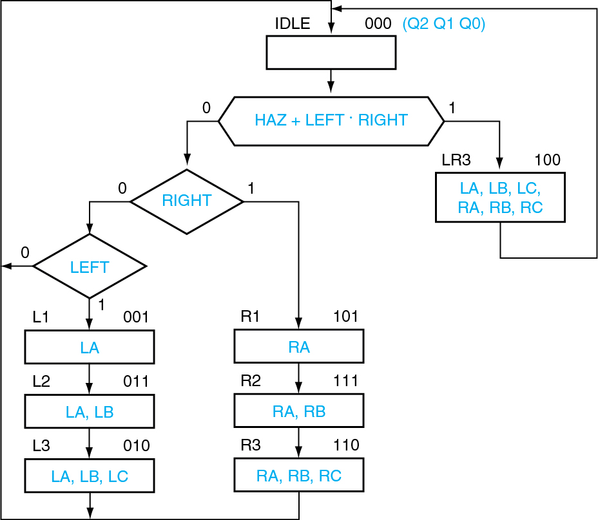
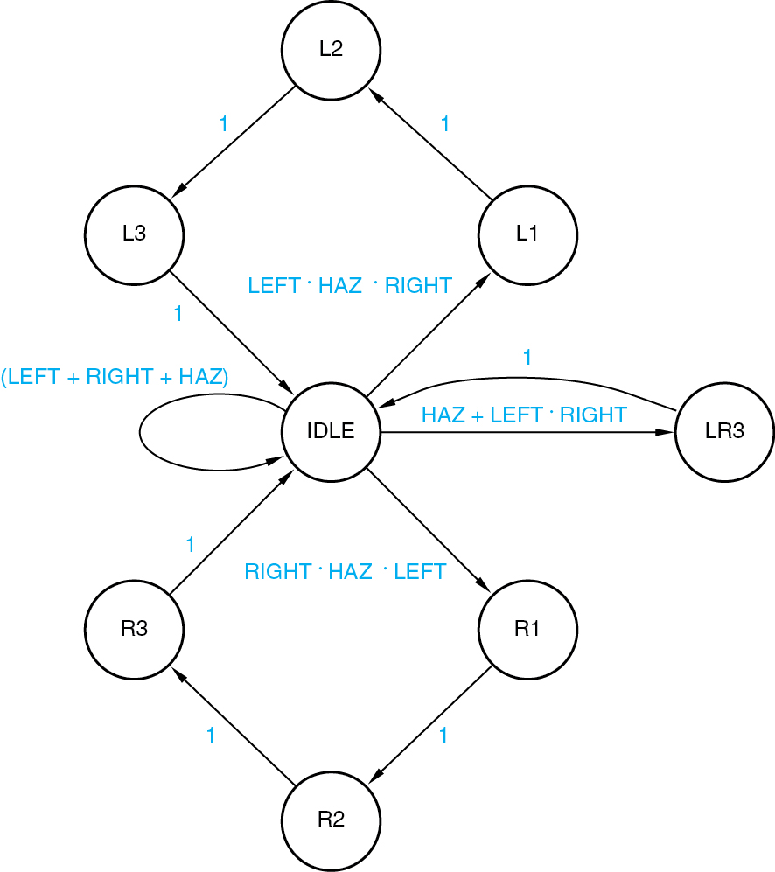
ASM vs FSM
Notes:
Wakerly 5th Edition

Slide 23
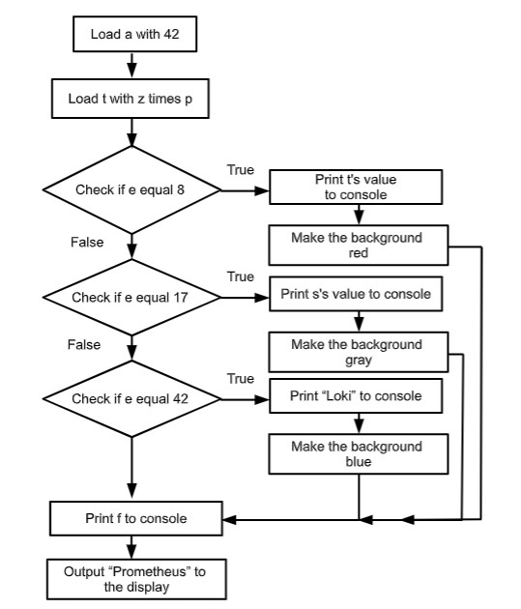
Flow Chart
Very Very similar to an ASM…
but flow charts don’t have timing considered

Slide 24
Language
Complete sentences outside of lists
Captions on all figures
No pronouns
Descriptive
Concise
Tends to be passive tone
That dry “it shall be known…” type
Need help with grammar/spelling...try my friend grammarly.com (the free version is really helpful)
You can use the UB Writing center on your work: http://www.buffalo.edu/writing.html
Other references: Purdue OWL, Excelsior OWL, IEEE Citation Guide
Talk with a TA/Instructor

Slide 25
References
“Digital Design: Principles and Practice” 5th Edition, by John F. Wakerly. Pearson, 2017. ISBN-13: 978-0134460093, ISBN-10: 013446009X
“Digital Design With An Introduction to the Verilog HDL, VHDL, and SystemVerilog” 6th Edition, by M.Morris Mano and Michael D. Ciletti
“Fundamentals of Digital Logic with Verilog Design”, 1st Edition, by Stephen Brown and Zvonko Vranesic
Plus more in the notes on many pages

Slide 26


